Slide 1

Life as an LGBT person in Europe
A view of the results of the
2012 European Union lesbian, gay, bisexual and transgender survey
conducted by the European Union Agency for Fundamental Rights

Slide 2
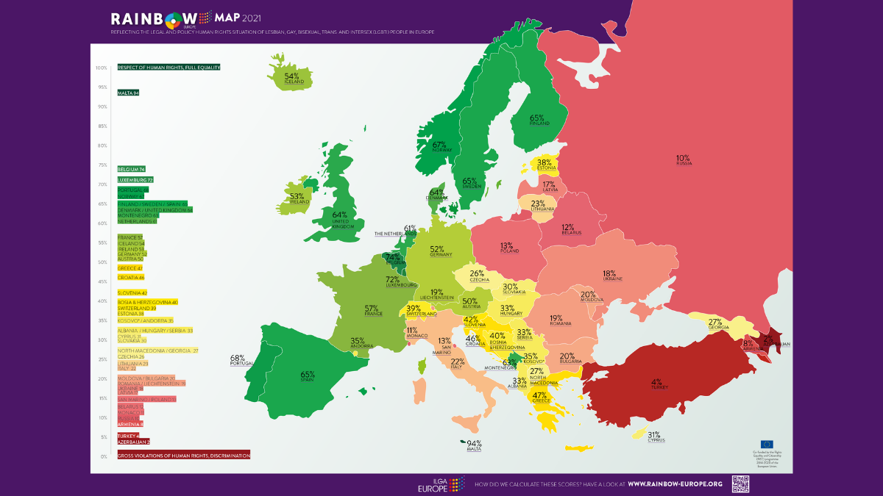
A survey? But… why?
There is already data about LGBT rights in Europe, look:
LGBT rights are very important, but don’t show people’s experiences and perceptions.
Notes:
You may ask why a survey.
ILGA Europe already procudes an overview of LGBT rights per country in the EU each year.
That’s truly great, and very useful for EU policy makers, human rights, activists, etc.
But what was missing was was the human side. People’s experiences and perception.

Slide 3
The survey:
Conducted online
Self selected sample
Promoted via LGBT specific media, LGBT associations, online groups, social media and dating apps.
93,079 respondents
From 28 EU countries

Slide 4
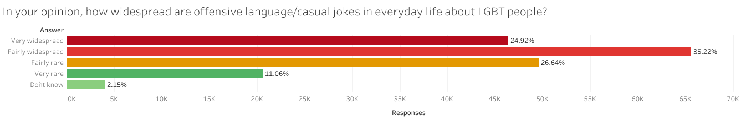
Let’s look at some results.
Words do matter.
So what do people hear in everyday life?
Notes:
Casual jokes are not funny, and offensive language does hurt.
25% of resopndents think it’s very widespread. And 60% of all respondents think it is fairly to very widespead.
Another 25% think it’s farly rare, which is better. But even hearing “fairly rarely” cruel jokes about your peers has an impact on people.

Slide 5
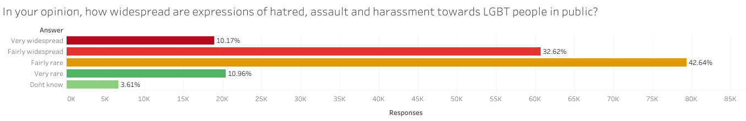
How about expressions of hatred, assault and harassment in public?
For 42% of the respondents, expressions of hatred, assault and harassment are fairly to very widespread in public.
Notes:
Offensive language and casual jokes are widespread, but what about actual expression of hatred, assault and harassment?
It’s not as bad, but still shockingly common to hear!

Slide 6
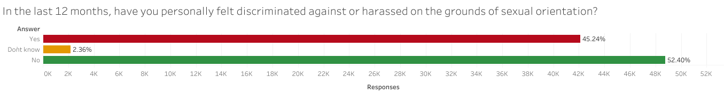
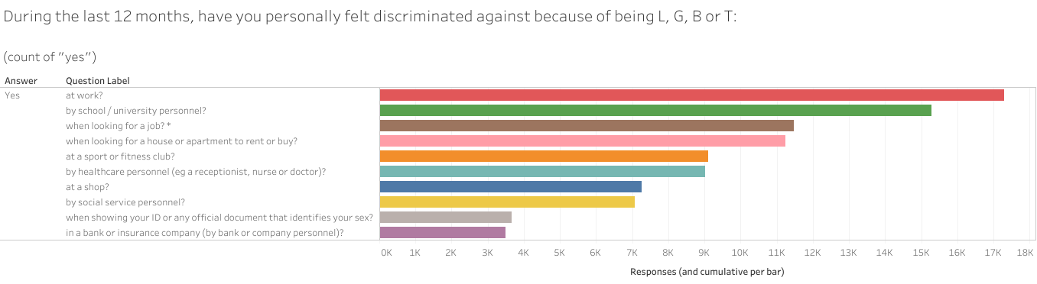
Is discrimination common?
Nearly half of the respondents have felt discriminated against on the grounds of their sexual orientation. Most of it happened at work or school/university.
We can see that work and school are two situations where discrimination is at its highest.
Notes:
Discrimination can range from being refused service (cabs in Amsterdam) to being passed on for a promotion at work, etc. This happened to 45% of the respondents in the last year (prior to the survey). It happened most often at work and school/university. Two areas that have high impact on people’s current and future life.

Slide 7
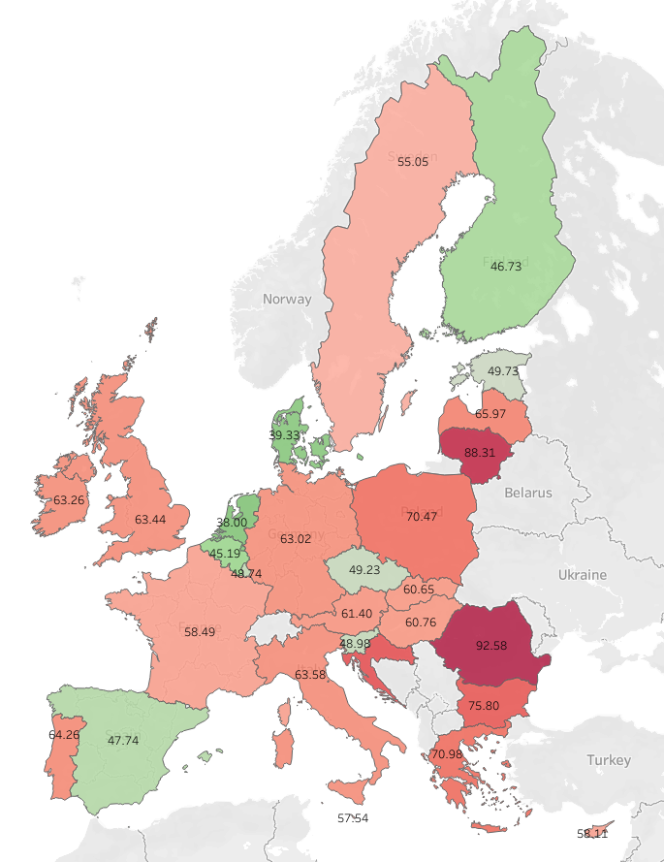
What does adding up the instances of discrimination mean on country level?
When looking at instances of discrimination in mutliple areas of life, we can see that the figures are high, with large differences per country.
Notes:
Adding up the instances of discrimination paints a much grimmer picture, with some countries reaching almost 100% of instances of discrimination per respondent.

Slide 8
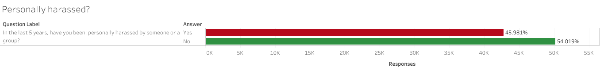
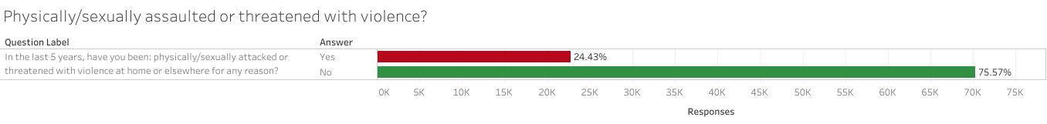
What about direct assaults or threats?
In the last 5 years, have you been…
While 45% of respondents have been personally harassed at east once in the last 5 years, the figure drops to 24% when refering to actual assault or threats of violence.
Still, 1 in 4 LGBT person in the EU has been faced with assault or threats of violence.
Notes:
We are no longer talking about being offensive language, or being discriminated against, but about being directly attacked simply for being who you are.

Slide 9
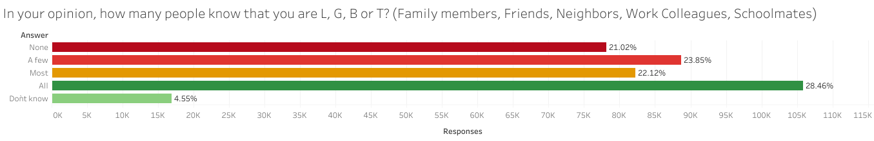
Given the issues, can respondents be open about being LGBT?
When being LGBT comes with so much negativity or even violence, some people have to hide. For 44% of respondents this means they cannot be themselves around all/most people.
Notes:
Let’s remember here that being ”out” doesn’t mean running around all day with a giant gay flag. It simply means that you don’t have to lie to your co-workers or family about what you’ve done on the weekend, or not having to lie about who you share your life with.
So yes, being out or not is important, and can have a great impact on quality of life.

Slide 10
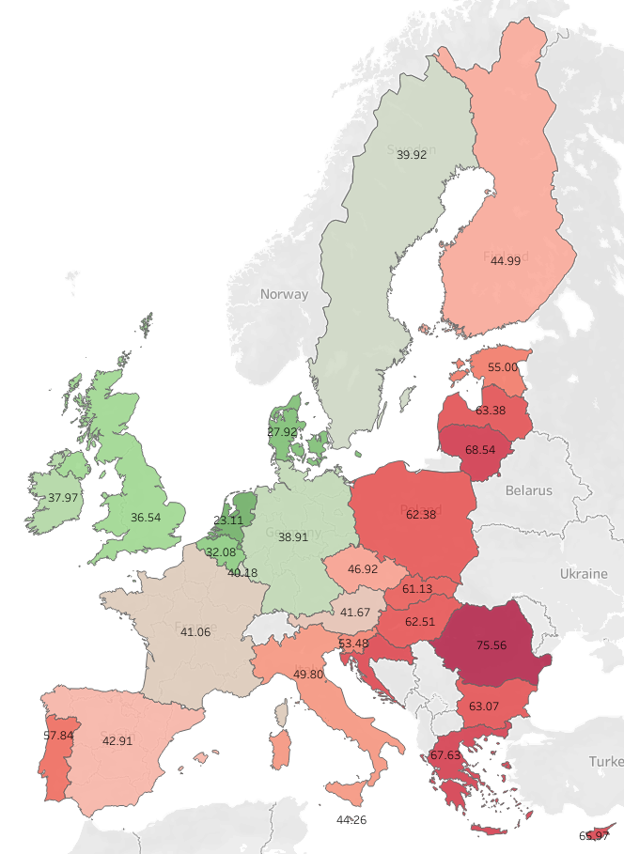
Being open or not, how does that differ per country?
There are visible differences between countries. While there is some correlation with countries with higher discrimination, it is not directly correlated.

Slide 11
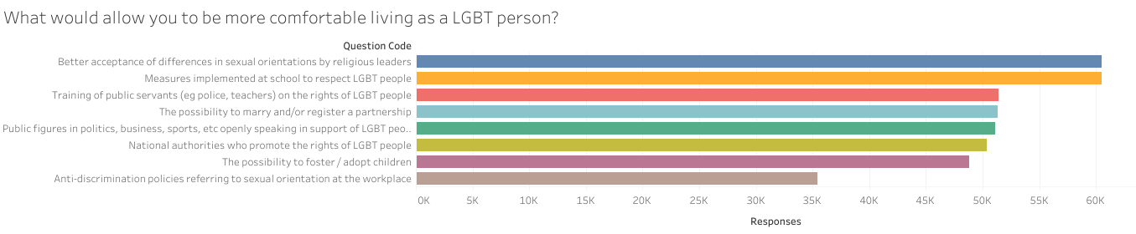
So… what now?
With a more in depth knowledge of the situation, we can effect change! The respondents strongly agree that the following would be useful:
Something everybody can do is be an active ally. Call people out if they use offensive language or ”jokes”, speak up when we see discrimination, etc.

Slide 12
Questions? Remarks?

